Slide 1
User Authentication and Access Control
Notes:
February 15, 209

Slide 2
User Authentication
Prove to a digital system who the user is
Once authentication is done, system can apply access control to decide what user can access
Ideally authentication proves
Who you are
Practically this proof is done using
Something you know (e.g., password)
Something you have (e.g., token)
Something about you (biometric - static feature or dynamic action)
Multifactor authentication – combination of approaches (e.g., password and SMS to the phone)

Slide 3
Password Authentication
User registers with a username and password
This input is stored on the server
Alice inputs her password, server verifies this against list of passwords
If there is a match, let user in
Use user’s identity to establish roles (superuser, member of a group, etc)
Use user’s identity for access control – what this user can and cannot do

Slide 4

Using One-Way Hashes
Storing plaintext passwords on a server is bad
If the server is compromised, the attacker learns everyone’s password
The attacker can use this information on other servers in the organization or outside of it
We can store username and hash of password
Alice inputs her password, server hashes it and compares against list of password hashes
SERVER
alice123
username | password
alice | f0034ab8c
hash
f0034ab8c
=?

Slide 5
Attacks on Password Auth.
Dictionary attack – guessing passwords
Offline: Guess any password on the server by comparing guesses to a list of precomputed hashes of popular pass.
Online: Try to guess a specific user’s password by trying popular passwords
Personal information attack
Online: Try to guess a specific user’s password by using personal information about the user
Reuse attack
Steal a password from one server, try it at other servers
Sniff a password from the network
Social engineering

Slide 6
Using Salt
To resist dictionary attacks we can use salt together with a password in hashing
A random number assigned to each user separately
Salt is stored in clear in the password table
During authentication salt is combined with the password to produce hash value
Salt makes offline dictionary attacks hard
A slow hash function makes online attacks hard
alice123
2549
SERVER
hash
username | password | salt
alice | 8703a9bc1 | 2549
8703a9bc1
=?

Slide 7
Password File Access Control
On UNIX systems password table is stored in the file /etc/shadow, which is only accessible by superuser
This makes it harder for attackers to steal passwords for offline attacks
Applications that run as superuser may have vulnerabilities, and exploiting them can give the attacker superuser privileges

Slide 8
Lamport Hash
Someone sniffing on the network can learn the password if it is transmitted in clear
Encrypt communication
If replay attacks are possible, someone can still steal passwords and reuse them
Lamport hash or S-KEY – time-varying password
To set-up the system, Alice enters random number R
Host calculates x₀₌h(R), x₁₌h(h(R)), x₂₌h(h(h(R))),..., x₁₀₀
Alice keeps this list, host sets her password to x₁₀₁
Alice logs on with x₁₀₀, host verifies h(x₁₀₀)=x₁₀₁, resets password to x₁₀₀
Next time Alice logs on with x₉₉

Slide 9
Shared Key Authentication
Challenge-response protocol: 3 flavors
Server sends random number R
Client encrypts with shared key, sends back
or
Server sends random number R, encrypted with shared key
Client decrypts, sends back
or
Server sends random number R
Client decrypts, sends back R-1, encrypted with shared key

Slide 10
Public Key Authentication
Challenge-response protocol: 2 flavors
Server sends random number R
Client encrypts with private key, sends back
or
Server sends random number R, encrypted with public key of client
Client decrypts, sends back

Slide 11
Single Sign-On
User has one username and password
Logs into SSO identity provider
The provider establishes trust with other sites and vouches for the user
Advantages:
No need to remember multiple passwords
Lowers user effort for logging in
Disadvantages:
That one password opens access to many systems
User may unwittingly stay logged on to SSO

Slide 12
One Identity Provider
Various systems share trust with one identity provider
User accesses a desired system
System redirects user to identity provider
Identity provider requires log in if not logged in already
Identity provider returns a token to the system, encrypted using a shared key
Examples: Passport, OpenID, Facebook login, Google login
access protected system
encrypted token w user info
username/pass
ask for auth
ask for login info

Slide 13
Multiple Identity Providers
Aka federated identity framework
Various systems share trust with all identity providers
User accesses a desired system
System decides which identity provider (IdP) to use, redirects user to identity provider
Identity provider requires log in if not logged in already
Identity provider returns a token to the system, encrypted using a shared key
Examples: Active Directory, Shibboleth
access protected system
encrypted token w user info
username/pass
Find the IdP ask for auth
ask for login info

Slide 14
Cookie-based Authentication
Placed into browser cache by servers to store state about this particular user
Contain any information that server wants to remember about the user as name/value pairs
May contain expiration time
May persist across browser instances
Returned to server in clear on new access
Only those cookies created for the server’s domain are sent to the server
E.g., cookies for usc.edu will be returned to www.usc.edu
May not be created by this server
Usually used for persistent sign in, shopping cart, user preferences

Slide 15
Cookie-based Authentication
User logs in using her username/pass
Server sets a cookie with some info – ideally NOT including password, and resistant to replay
For example: session ID encrypted with secret key
Any future accesses return this info to the server who uses it for authentication (equivalent to user/pass)
Once user signs out the cookie is deleted and the session closed at the server
Problems
Cookies can be sniffed, remain on the browser because user did not sign out, be stolen by cross-site scripting or via DNS poisoning
Solutions:
Send cookies over SSL, use timed cookies, secure code, bind cookies to IP address of the client, encrypt cookies …

Slide 16
Token-based Authentication
Magnetic stripe cards
Store fixed information
Smart cards
Store information and can perform some processing
Can respond to challenges
Yubi keys
Time-varying passwords
Single-use passwords
Pseudo-random generation synchronized with the server, function of shared key and time

Slide 17
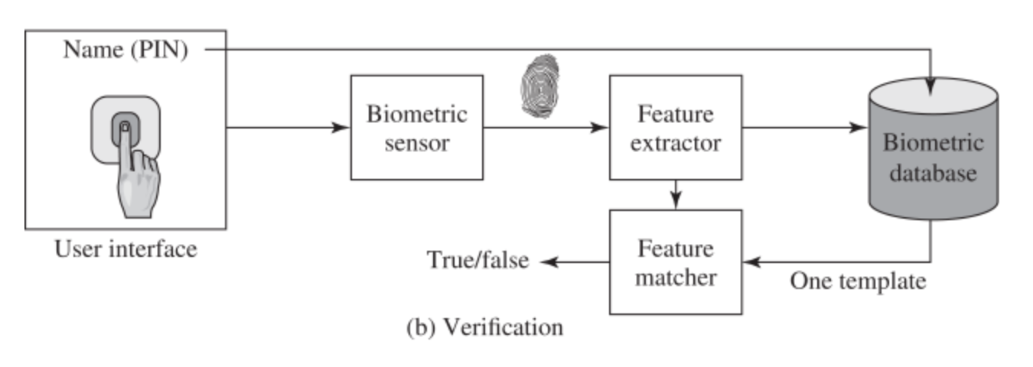
Biometric Authentication
Measures some physical attribute of the user
Static attribute
Iris scan
Fingerprint
Picture
Dynamic attribute
Voice (could be challenge/response)
Heartbeat
Typing style
Making facial expressions (challenge/response)
Gait

Slide 18
Access Control
Is principal P permitted to perform action A on object O?
Authorization system will provide yes/no answer
We assume that authentication has established identity of principal P
Example: P: username, A: read/write/exe, O: file

Slide 19
Access Control Schemes
Discretionary
Mandatory
Role-based
Attribute-based
A system may deploy several of these access control schemes to satisfy different security needs

Slide 20
Discretionary Access Control
Owners control access to objects
And can grant access to other principals
Access permissions based on identity of subject/object
E.g., access to health information or file system access

Slide 21
Access Control Matrix
Columns indexed by principal
Rows indexed by objects
Elements are arrays of permissions indexed by action
In practice, ACMs are abstract objects
Huge and sparse, and possibly distributed
File/User | Tom | Dick | Harry
Readme.txt | read | read | read, write
passwords |  |  | write
Term.exe | read, write, execute

Slide 22
Instantiations of ACMs
Access Control Lists (ACLs)
For each object, list principals and actions permitted on that object
Corresponds to rows of ACM
Easy to see who has access to a given resource but hard to see what are all the resources a user can access
File
Readme.txt | Tom: read, Dick: read, Harry: read, write
passwords | Harry: write
Term.exe | Tom: read, write, execute

Slide 23
Instantiations of ACMs
Capabilities
For each principal, list objects and actions permitted for that principal
Corresponds to columns of ACM
Easy to see what a user can access, but hard to see who has access to a given resource
The Unix file system is an example of…?
User
Tom | Readme.txt: read, Term.exe: read, write, execute
Dick | Readme.txt: read
Harry | Readme.txt: read, write; passwords: write

Slide 24
Mandatory Access Control
Rules set by the system, cannot be overriden by owners
Each object has a classification and each subject has a clearance (unclassified, classified, secret, top-secret)
Rules speak about how to match categories and classifications
Access is granted on a match

Slide 25
Bell-LaPadula Policy Model
Focuses on controlled access to classified information and on confidentiality
No concern about integrity
Subjects with higher clearance cannot reveal information to subjects with lower clearance
The model is a formal state transition model of computer security policy
Describes a set of access control rules which use security classification on objects and clearances for subjects
top secret > secret > confidential > restricted > unclassified
To determine if a subject can access an object
Combine mandatory and discretionary AC (ACM)
Compare object’s classification with subject’s clearance
Allow access if ACM and level check say it’s OK

Slide 26
Bell-LaPadula Policy Model
Actions: read, append, write (read+append), execute
Mandatory access control rules:
a subject at a given clearance may not read an object at a higher classification (no read-up)
a subject at a given clearance must not write to any object at a lower classification (no write-down)
Append is allowed on objects of the same or higher classification
Write is allowed only on objects of the same classification
Trusted subjects – the “no write-down” rule does not apply to them
Transfer info from high clearance to low clearance

Slide 27
Role-Based Access Control
Ability to access objects depends on one’s role in the organization
A user can have many roles, and many users can have a given role
Roles of a user can change
Restrictions may limit holding multiple roles simultaneously or within a session, or over longer periods.
Supports separation of roles
Maps to organization structure

Slide 28
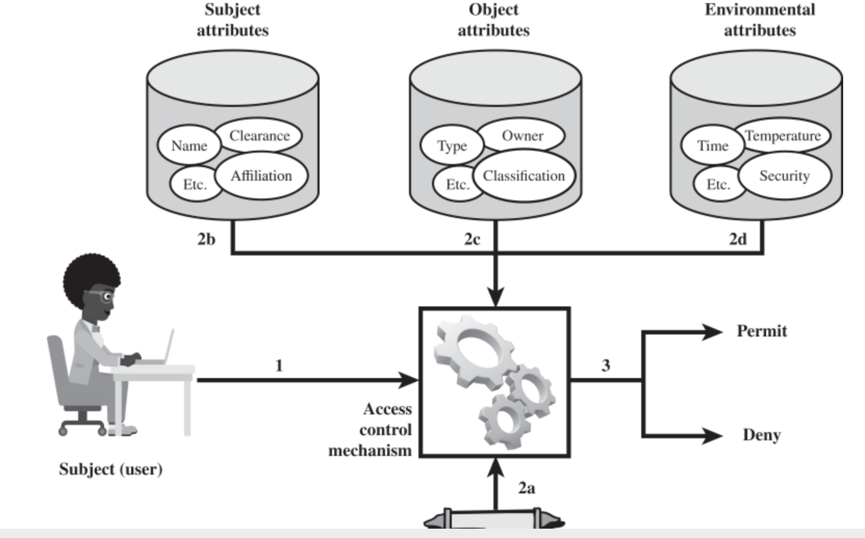
Attribute-Based Access Control
Ability to access objects depends on attributes assigned to user and object, and on environment attributes
Attributes can have single value (clearance) or multiple values (project membership)
Example:
students can view their grades only during weekdays and for courses that they took less than 3 years ago

Slide 29
Bell-LaPadula Exercise
Tom has top secret clearance, Ella has secret and John has no clearance
There are three files: file-a has top secret classification, file-b is restricted and file-c is unclassified
ACM gives Tom read rights on file-a, file-b and file-c and write rights on file-a and file-c. Ella has read rights on file-a and file-c and no write rights. John has read rights on file-c and write rights on file-b.
Who can read file-a? Who can write file-a? R(T) W(T)
Who can read file-b? Who can write file-b? R(T) W(J)
Who can read file-c? Who can write file-c? R(T,E,J) W(0)

